Slide 1
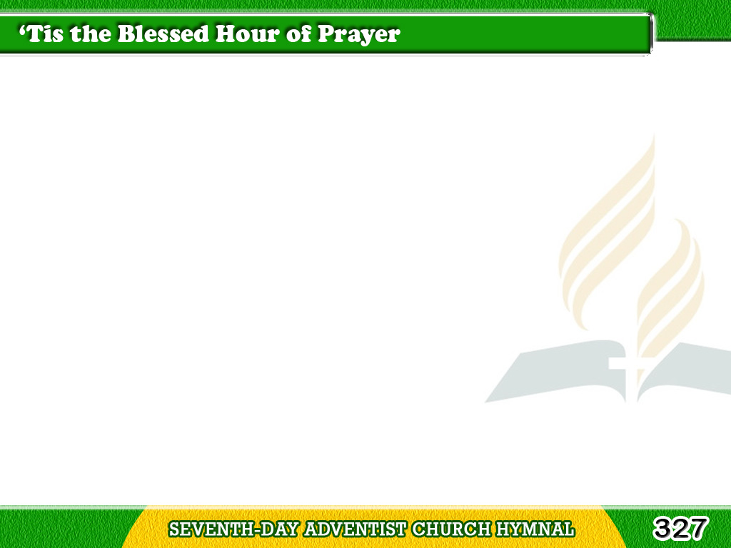
1/4
‘Tis the blessed hour of prayer,
when our hearts lowly bend,
And we gather to Jesus,
our Savior and Friend;
Tagalog
Version

Slide 2
1/4
If we come to Him in faith,
His protection to share,
What a balm for the weary!
O how sweet to be there!
Tagalog
Version

Slide 3
1/4
Chorus
Blessed hour of prayer,
Blessed hour of prayer,
What a balm for the weary!
O how sweet to be there!
Tagalog
Version

Slide 4
2/4
‘Tis the blessed hour of prayer,
when the Savior draws near,
With a tender compassion
His children to hear;
Tagalog
Version

Slide 5
2/4
When He tells us we may cast
at His feet every care,
What a balm for the weary!
O how sweet to be there!
Tagalog
Version

Slide 6
2/4
Chorus
Blessed hour of prayer,
Blessed hour of prayer,
What a balm for the weary!
O how sweet to be there!
Tagalog
Version

Slide 7
3/4
‘Tis the blessed hour of prayer,
when the tempted and tried
To the Savior who loves them
their sorrows confide;
Tagalog
Version

Slide 8
3/4
With a sympathizing heart
He removes every care;
What a balm for the weary!
O how sweet to be there!
Tagalog
Version

Slide 9
3/4
Chorus
Blessed hour of prayer,
Blessed hour of prayer,
What a balm for the weary!
O how sweet to be there!
Tagalog
Version

Slide 10
4/4
At the blessed hour of prayer,
trusting Him we believe,
That the blessings we’re needing
we’ll surely receive;
Tagalog
Version

Slide 11
4/4
In the fullness of this trust
we shall lose every care;
What a balm for the weary!
O how sweet to be there!
Tagalog
Version

Slide 12
4/4
Chorus
Blessed hour of prayer,
Blessed hour of prayer,
What a balm for the weary!
O how sweet to be there!
Tagalog
Version

